Slide 1



Team Miss Marple
SQL Murder

Slide 2

(1) Importamos pandas y sqlite3
(2) Establecemos conexión con la base de datos
(3) Creamos DataFrames de pandas con cada tabla de la base de datos
Resolución
con SQL
Resolución
con Pandas

Slide 3
Tablas: ‘crime_scene_report’ y ‘person’
SQL
Pandas
query = '''
SELECT description
FROM crime_scene_report
WHERE date = '20180115' AND
type = 'murder' AND
city = 'SQL City';
'''
pd.read_sql_query(query, conn)
mascara = (crime_scene_report["date"] == 20180115) & \
(crime_scene_report["city"] == "SQL City") & \
(crime_scene_report["type"] == "murder")
condicion = crime_scene_report[mascara]
condicion
Testigos: Annabel Miller y Morty Shapiro

Slide 4
Tabla: ‘interview’
SQL
Pandas
query = '''
SELECT transcript
FROM interview
WHERE person_id = '16371'
'''
pd.read_sql_query(query, conn)
mascara = (interview["person_id"] == 16371)
condicion = interview[mascara]
condicion
Información del asesinato y datos del asesino

Slide 5
Tablas: ‘get_fit_now_check_in’ y ‘person’
SQL
Pandas
query = '''
SELECT membership_id
FROM get_fit_now_check_in
WHERE membership_id LIKE '48Z%' AND check_in_date = '20180109'
'''
pd.read_sql_query(query, conn)
)
mascara = ((get_fit_now_check_in["membership_id"].str.startswith("48Z")) & \
(get_fit_now_check_in["check_in_date"] == 20180109))
condicion = get_fit_now_check_in[mascara]
condicion
Asesino: Jeremy Bowers

Slide 6
Tablas: ‘driver_license’ y ‘person’
SQL
Pandas
query = '''
SELECT p.name, d.height, d.hair_color, d.car_make, d.car_model, d.gender
FROM drivers_license AS d
JOIN person AS p ON d.id = p.license_id
WHERE d.height BETWEEN 65 AND 67
AND d.hair_color = 'red'
AND d.gender = 'female'
AND d.car_make = 'Tesla'
AND d.car_model = 'Model S'
AND p.id IN (
SELECT f.person_id
FROM facebook_event_checkin AS f
WHERE f.event_name = 'SQL Symphony Concert'
);
'''
pd.read_sql_query(query, conn)
merged = pd.merge(drivers_license, person, left_on='id', right_on='license_id', how="inner")
merged.columns
condicion = merged[
(merged['height'].between(65, 67)) &
(merged['hair_color'] == 'red') &
(merged['gender'] == 'female') &
(merged['car_make'] == 'tesla') &
(merged['car_model'] == 'model s')
]
event_person_ids = facebook_event_checkin[facebook_event_checkin['event_name'] == 'SQL Symphony Concert']['person_id']
condicion = condicion[condicion['id_y'].isin(event_person_ids)]
condicion["name"]
Miranda Priestly es la persona quién encargó el crimen

Slide 7

Team Miss Marple

Slide 8

(1) Conectamos a una base de datos llamada:
resultado_Miss_Marple.db
(2) Creamos 5 tablas con el comando: CREATE TABLE IF NOT EXISTS
proveedor
categoria
pieza
pieza_categoria
suministro
idCategoria
idPieza
idProveedor
idCategoria
idPieza
idPieza
idProveedor

Slide 9
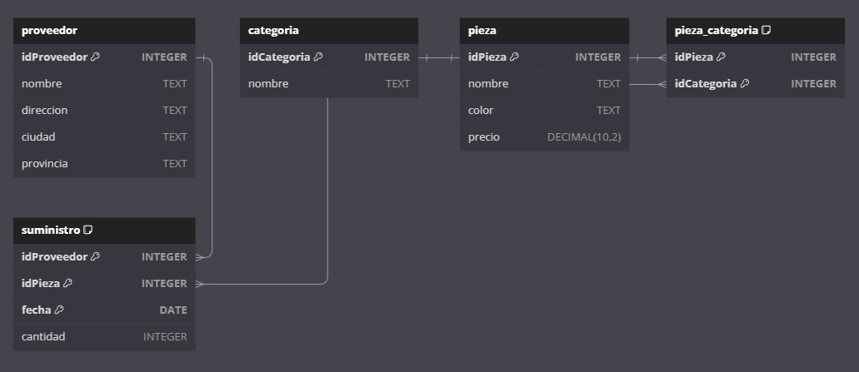
DBDiagram.io

